Slide 1
Roots Africa Data Dashboard Final Presentation
Bruck Getnet, Scott Chen, Demetrios Tzamaras, Rish Banga, Ildreed Mbami, Yosef Tsigie

Slide 2






Team Members
Project Manager
Rishabh Banga
Research Lead
Bruck Getnet
UX Designer
Scott Chen
Technical Lead
Demetri Tzamaras
Data Analyst
Yosef Tsigie
Client Lead
Ildreed Mbami

Slide 3
Our Journey
Who We Are: Information Science students specializing in data visualization and dashboard development
Client: Roots Africa, an NGO working to end hunger and poverty through agricultural education and entrepreneurship development in Liberia and Uganda
Mission: Create a comprehensive data monitoring dashboard to help Roots Africa track and showcase their community transformation efforts
Project Timeline: January - May 2025

Slide 4
About Roots Africa
Founded by Cedric Nwafor, who immigrated from Cameroon to the US in 2010
Mission: "Africa doesn't need charity, it needs changemakers"
Trained 648 changemakers who have trained 11,349 farmers
45% of change makers continue training without direct support
Focus on resilient agriculture and entrepreneurship development
"Roots Africa was founded by Cedric Nwafor, who immigrated from Cameroon to the US in 2010. Their guiding philosophy is captured in their powerful mission statement: 'Africa doesn't need charity, it needs changemakers.' This organization has had remarkable reach, training 648 changemakers who have in turn trained over 11,300 farmers across Liberia and Uganda. What's particularly impressive is that 45% of these changemakers continue training farmers without any direct support - showing the sustainability of their model. Their work focuses on two key pillars: resilient agriculture to address food security and entrepreneurship development to create economic opportunity."

Slide 5
Approach & Impact
"Roots Africa's approach is centered on community-led agricultural initiatives that emphasize working with existing resources rather than creating dependency. They've built an impressive network connecting African changemakers with 175 global mentors and instructors, with 83% of changemakers maintaining these valuable connections over time. The results speak for themselves - 7 in 10 households have increased their income after training, and 30 pods have even created their own consulting businesses focused on training other farmers. This multiplier effect demonstrates how their model builds sustainable and locally-driven transformation rather than temporary relief."
Community-led agricultural initiatives emphasizing resource optimization
Global mentor connections with 175 instructors worldwide
83% of changemakers maintain connections with mentors
7 in 10 households increased income after training
30 pods have created consulting businesses focused on training other farmers

Slide 6
Project Obstacles
"Before getting into the problems our dashboard helped to solve, I want to talk about the obstacles we encountered during our work with Roots Africa. Communication with our client required patience as response times occasionally extended to 1-2 days, which affected our workflow. More significantly, we had to navigate a multi-step communication chain where information had to flow from our team to Cedric, then to field agents, and back through the same channel. This created information bottlenecks that sometimes slowed progress. Additionally, since the real data collection process is currently ongoing, we needed to create simulated datasets to meet our project deadlines. Despite these obstacles, we were able to adapt our approach and deliver a solution that meets their needs."
Retry
Claude can make mistakes.
Please double-check responses.
Communication with client had delayed times, usually 1 or 2 days
Multi-step communication chain (our team → Cedric → field agents → Cedric → our team) created information bottlenecks
Limited access to real data necessitated creating simulated datasets to meet project deadlines

Slide 7
The Problem
Business Challenge
Despite training over 11,000 farmers across Liberia and Uganda, Roots Africa faces significant challenges in tracking, measuring, and communicating their impact
No centralized data visualization system for monitoring community transformation
Difficulty making data-informed decisions about resource allocation

Slide 8
Information Management Issues
Field data collection challenges in remote areas with limited connectivity
Need for unique identifiers to track farmers and communities over time
Lack of standardized metrics for measuring community maturity and readiness
Limited capacity to analyze collected data and generate actionable insights

Slide 9
The Solution
Proposed Solution
Comprehensive data dashboard integrating multiple data sources
Kobo Collect implementation for standardized field data collection
Interactive dashboard with geospatial visualization capabilities

Slide 10
Data Collection
Kobo Collect Surveys
Community Resource Mapping: Infrastructure, available services, natural resources, financial services
Community Readiness Assessment: Leadership structures, farmer groups, farming practices, market access
Individual Household Surveys: Income sources, farming techniques, food security, training interests
Community Maturity Assessment: Community-led initiative history, youth/women involvement, problem-solving approach

Slide 11
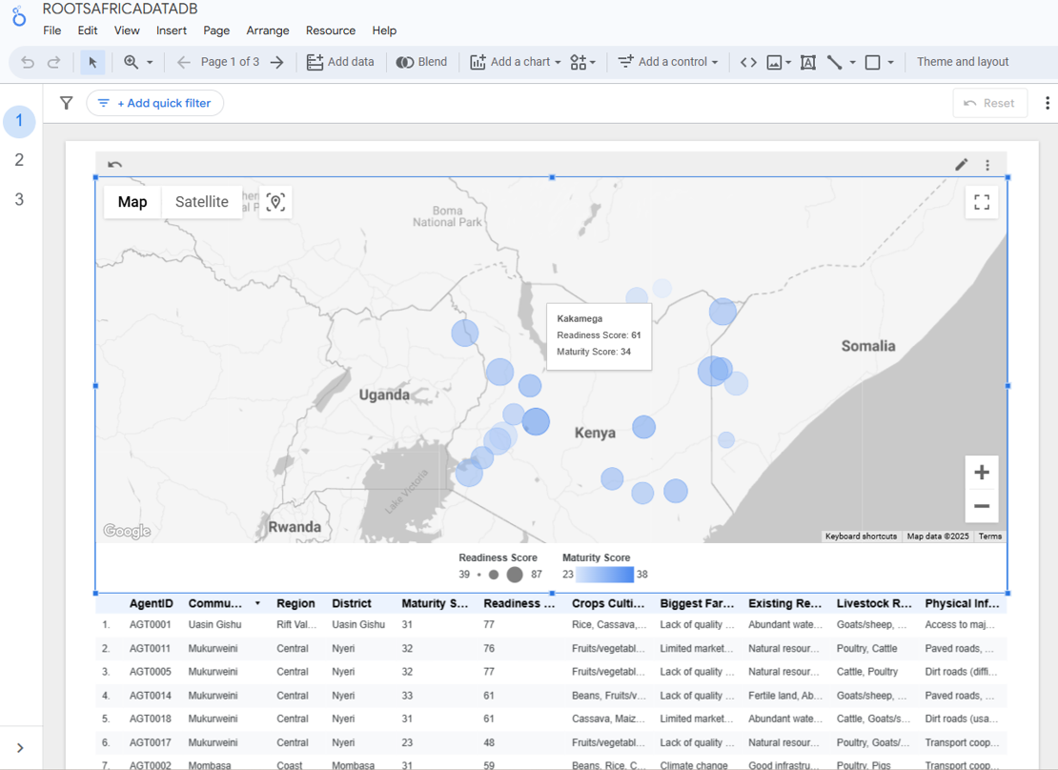
The Dashboard

Slide 12
The Dashboard
Key Dashboard Features
Geospatial mapping of communities
Community maturity score visualization
Readiness assessment tracking
Resource mapping integration
Household-level data filtering

Slide 13
Decision Making Tools
Community comparison visualization
Resource gap identification
Training impact measurement
Data export capabilities for reporting
Filtering by region, maturity stage, and crops

Slide 14
Analyzing the Field
Key Findings from Data
Communities with stronger leadership structures showed faster progress
Market access remains a significant barrier in most regions
Communities with youth involvement showed higher innovation rates
Common resource gaps: storage facilities, transportation infrastructure
Most communities fall in Growth (26-35) stage, indicating positive momentum

Slide 15
Challenges
Project Challenges
Technical Complexity: Integration between data collection and visualization
Connectivity Issues: Limited internet in rural areas of Liberia and Uganda
Data Quality: Ensuring consistent entry across field agents
Resource Constraints: Client has limited technical staff
Implementation Timeline: Balancing comprehensive features with project deadline

Slide 16
How we overcame them?
Prioritized offline functionality in Kobo Collect
Created comprehensive user guides with visual tutorials
Developed data validation procedures to ensure quality
Simplified dashboard interface for non-technical users
Phased implementation approach focusing on core requirements first

Slide 17
Results
Delivered Solutions
Data Collection System: Fully configured Kobo Collect with four survey types (Community Resource Mapping, Community Readiness, Household Surveys, Maturity Assessment)
Interactive Dashboard: Geospatial visualization showing community locations, maturity scores, readiness levels, and key agricultural data
User Documentation: Comprehensive guide for maintaining data collection and dashboard systems

Slide 18
Impact for Roots Africa
Identify communities most ready for transformation initiatives
Improve allocating resources based on maturity stage and specific community needs
Better reporting capabilities for donors and stakeholders
Long-term ability to track community progress
"This isn't just a technical solution, it's a transformation in how Roots Africa understands their impact"

Slide 19
Next Steps
Field agents must complete data collection for all communities
Develop training program for dashboard administrators
Explore advanced analytics capabilities to identify further success factors

Slide 20
Long-Term Vision
Vision of developing a community-facing dashboard for local leaders
Consider mobile app development for increased accessibility
"The long-term vision is for communities themselves to use data to drive their own transformation"

Slide 21
Thanks!
Do you have any questions?

